Slide 1

CSCI 1102 Computer Science 2
Meeting 13: Tuesday 3/16/2021
Sorting Algorithms

Slide 2
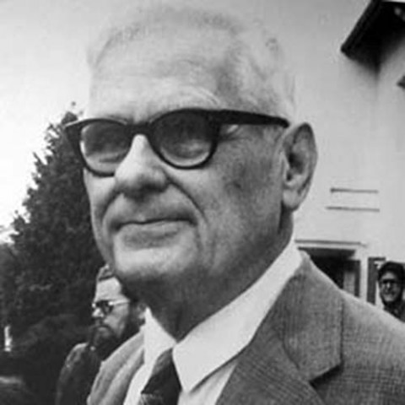
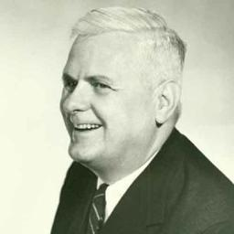
Alonzo Church

Slide 3
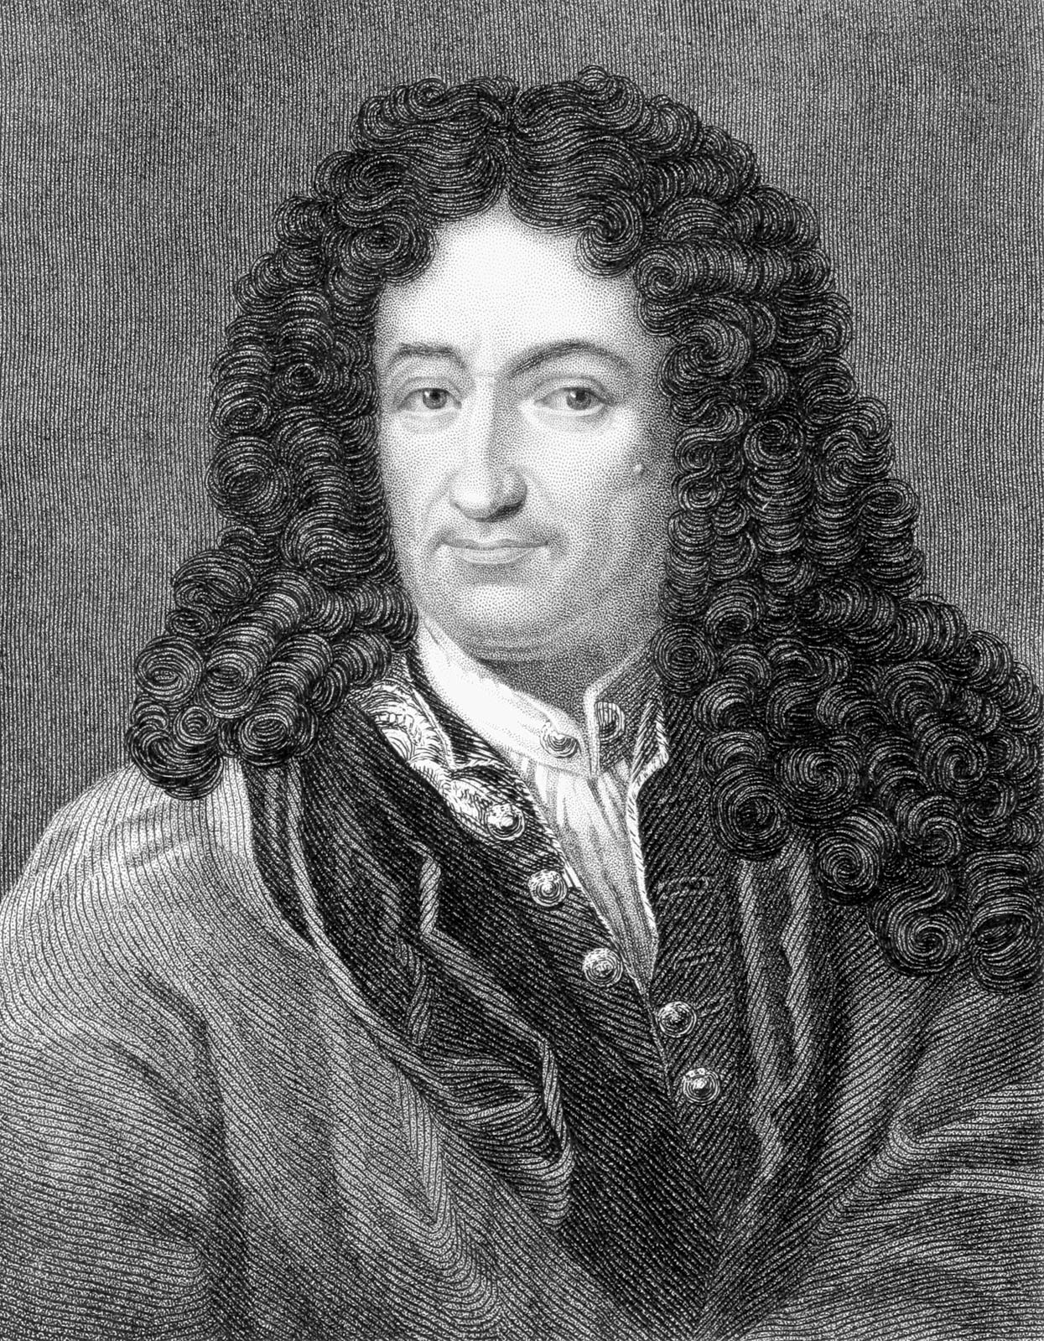
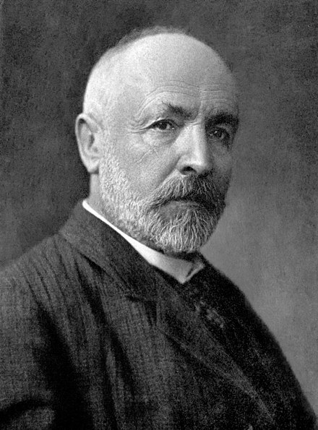
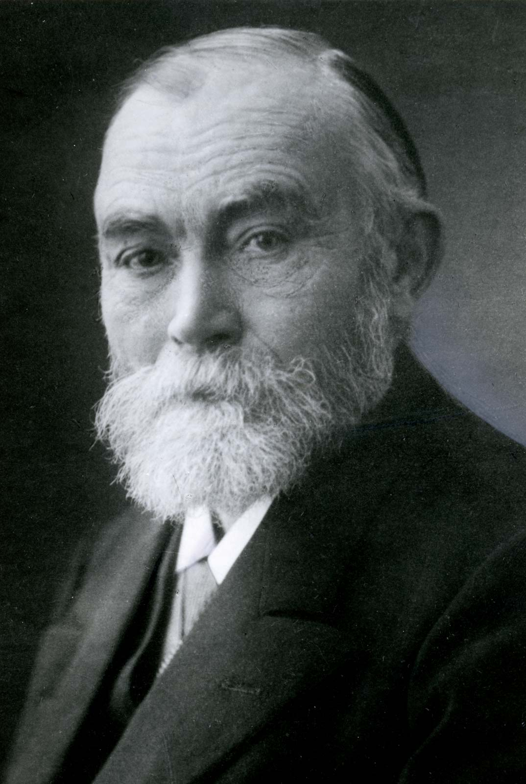
Gottfried Leibniz
Georg Cantor
Gottlob Frege

Slide 4
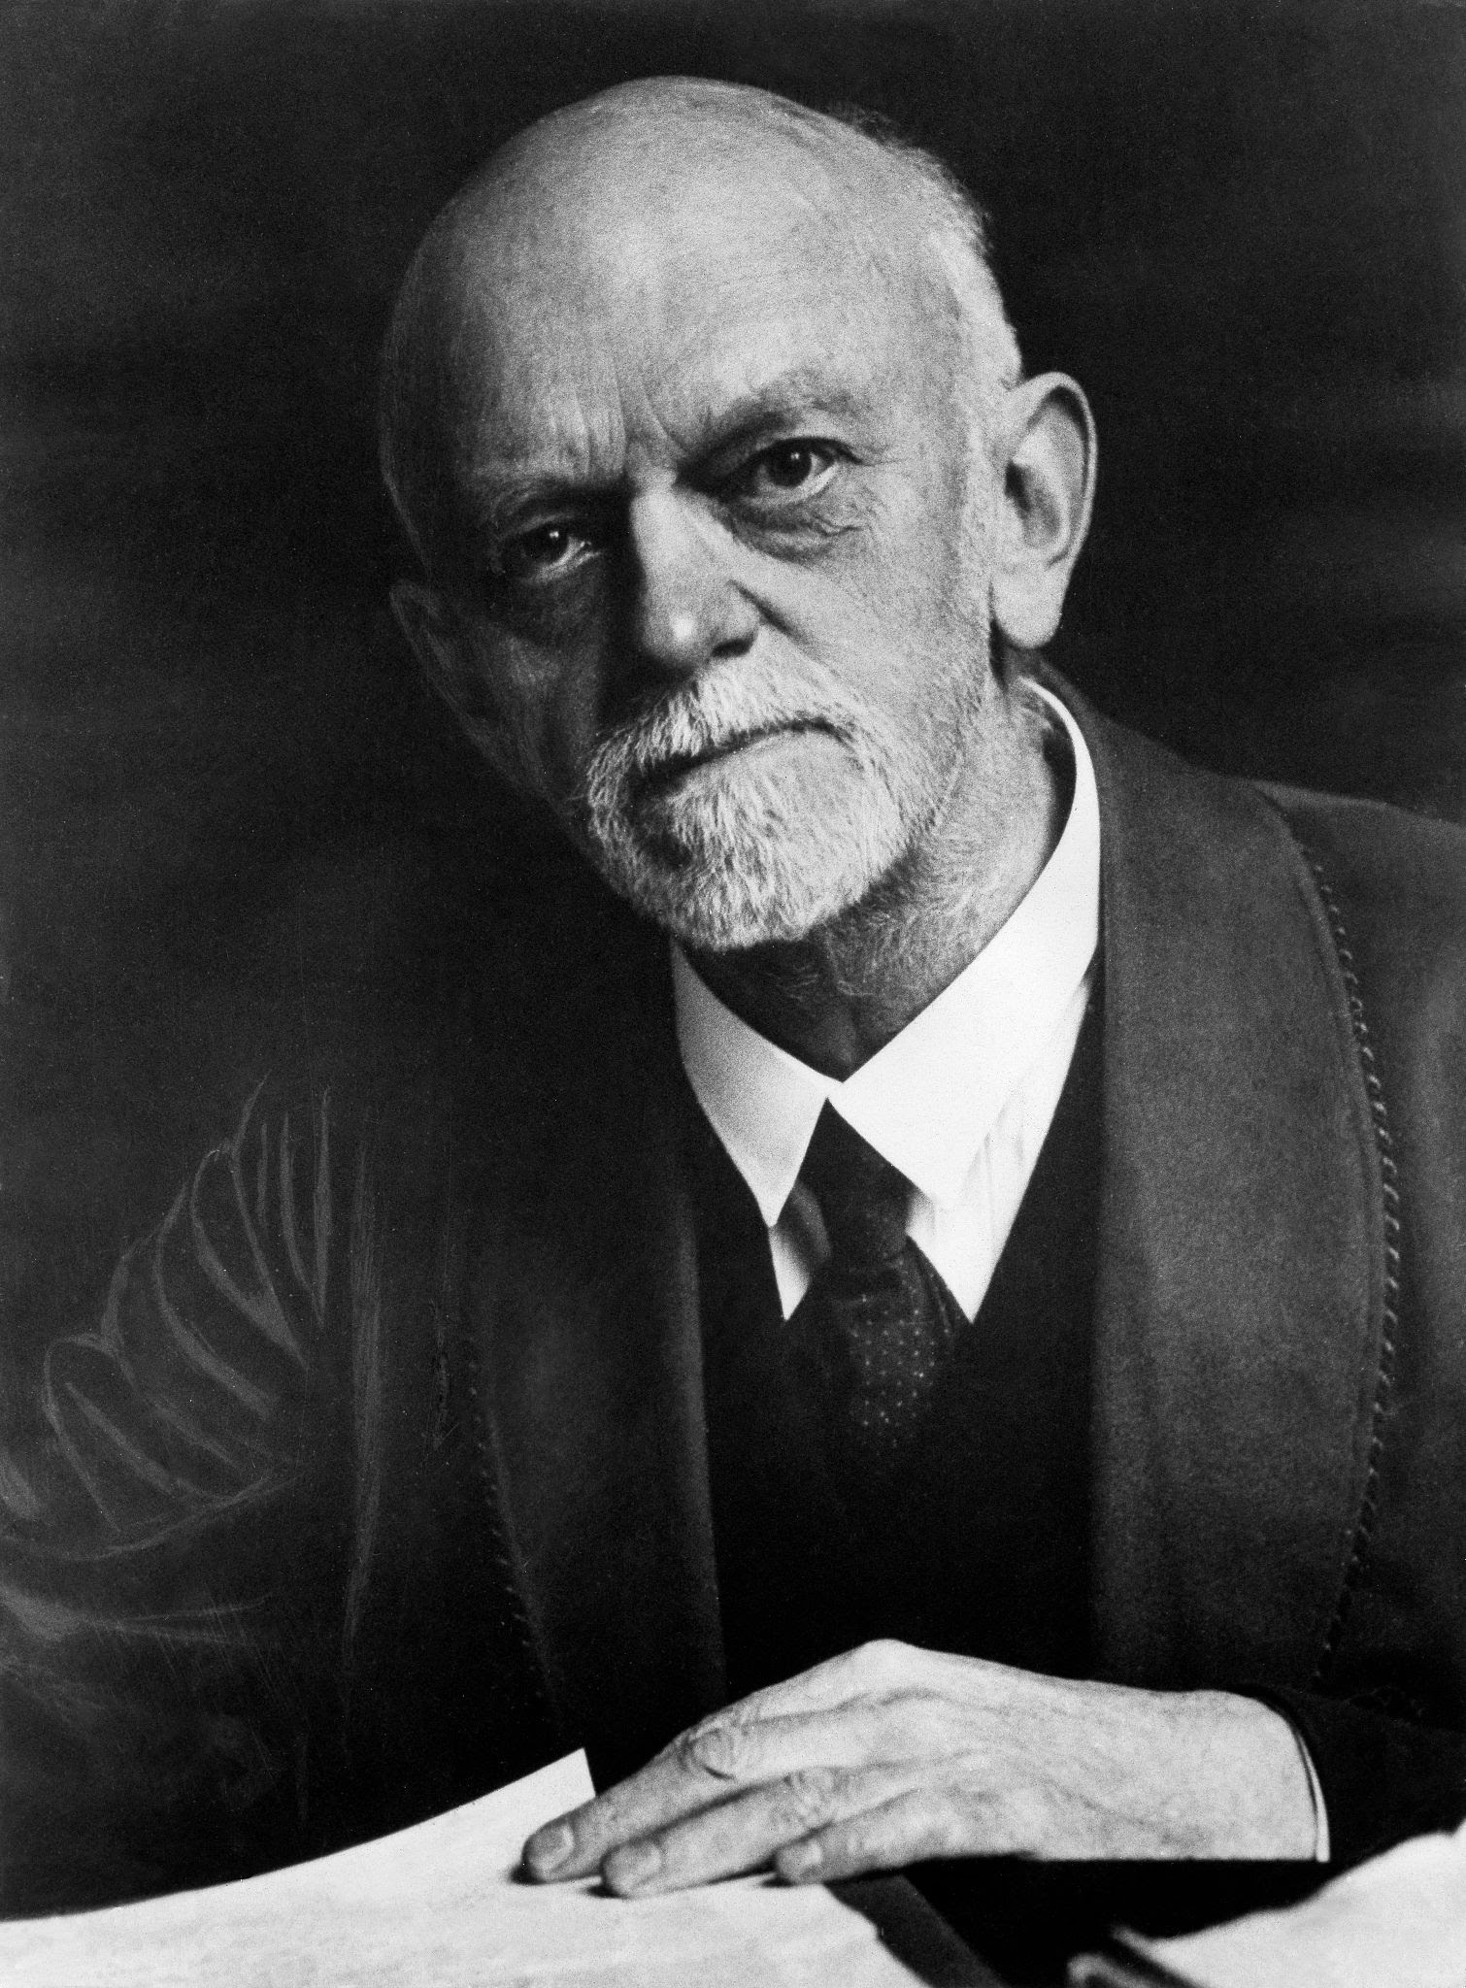
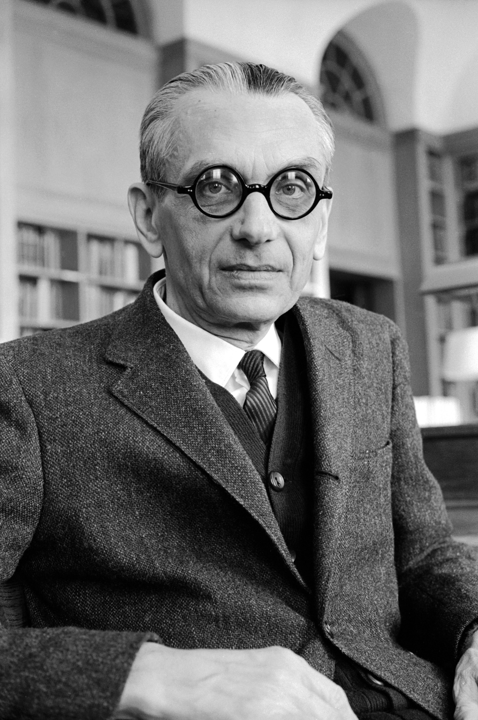
Georg Cantor
David Hilbert
Kurt Godel
David Hilbert

Slide 5
f(x) = 2x
{(0, 0), (1, 2), (2, 4), (3, 6), … }

Slide 6
M ::= x | (λx.M) | (M M)

Slide 7
Lambda Calculus
M ::= x | (λx.M) | (M M)
Variables
Functions
Function calls

Slide 8
Lambda Calculus
A mathematically well-founded theory of functions as computation rules.
A mathematically well-founded characterization of effectively computability.
The essence of a programming language.

Slide 9
Today
Sorting Algorithms
Notes:
Concept-Script: A Formal Language for Pure Thought Modeled on that of Arithmetic

Slide 10
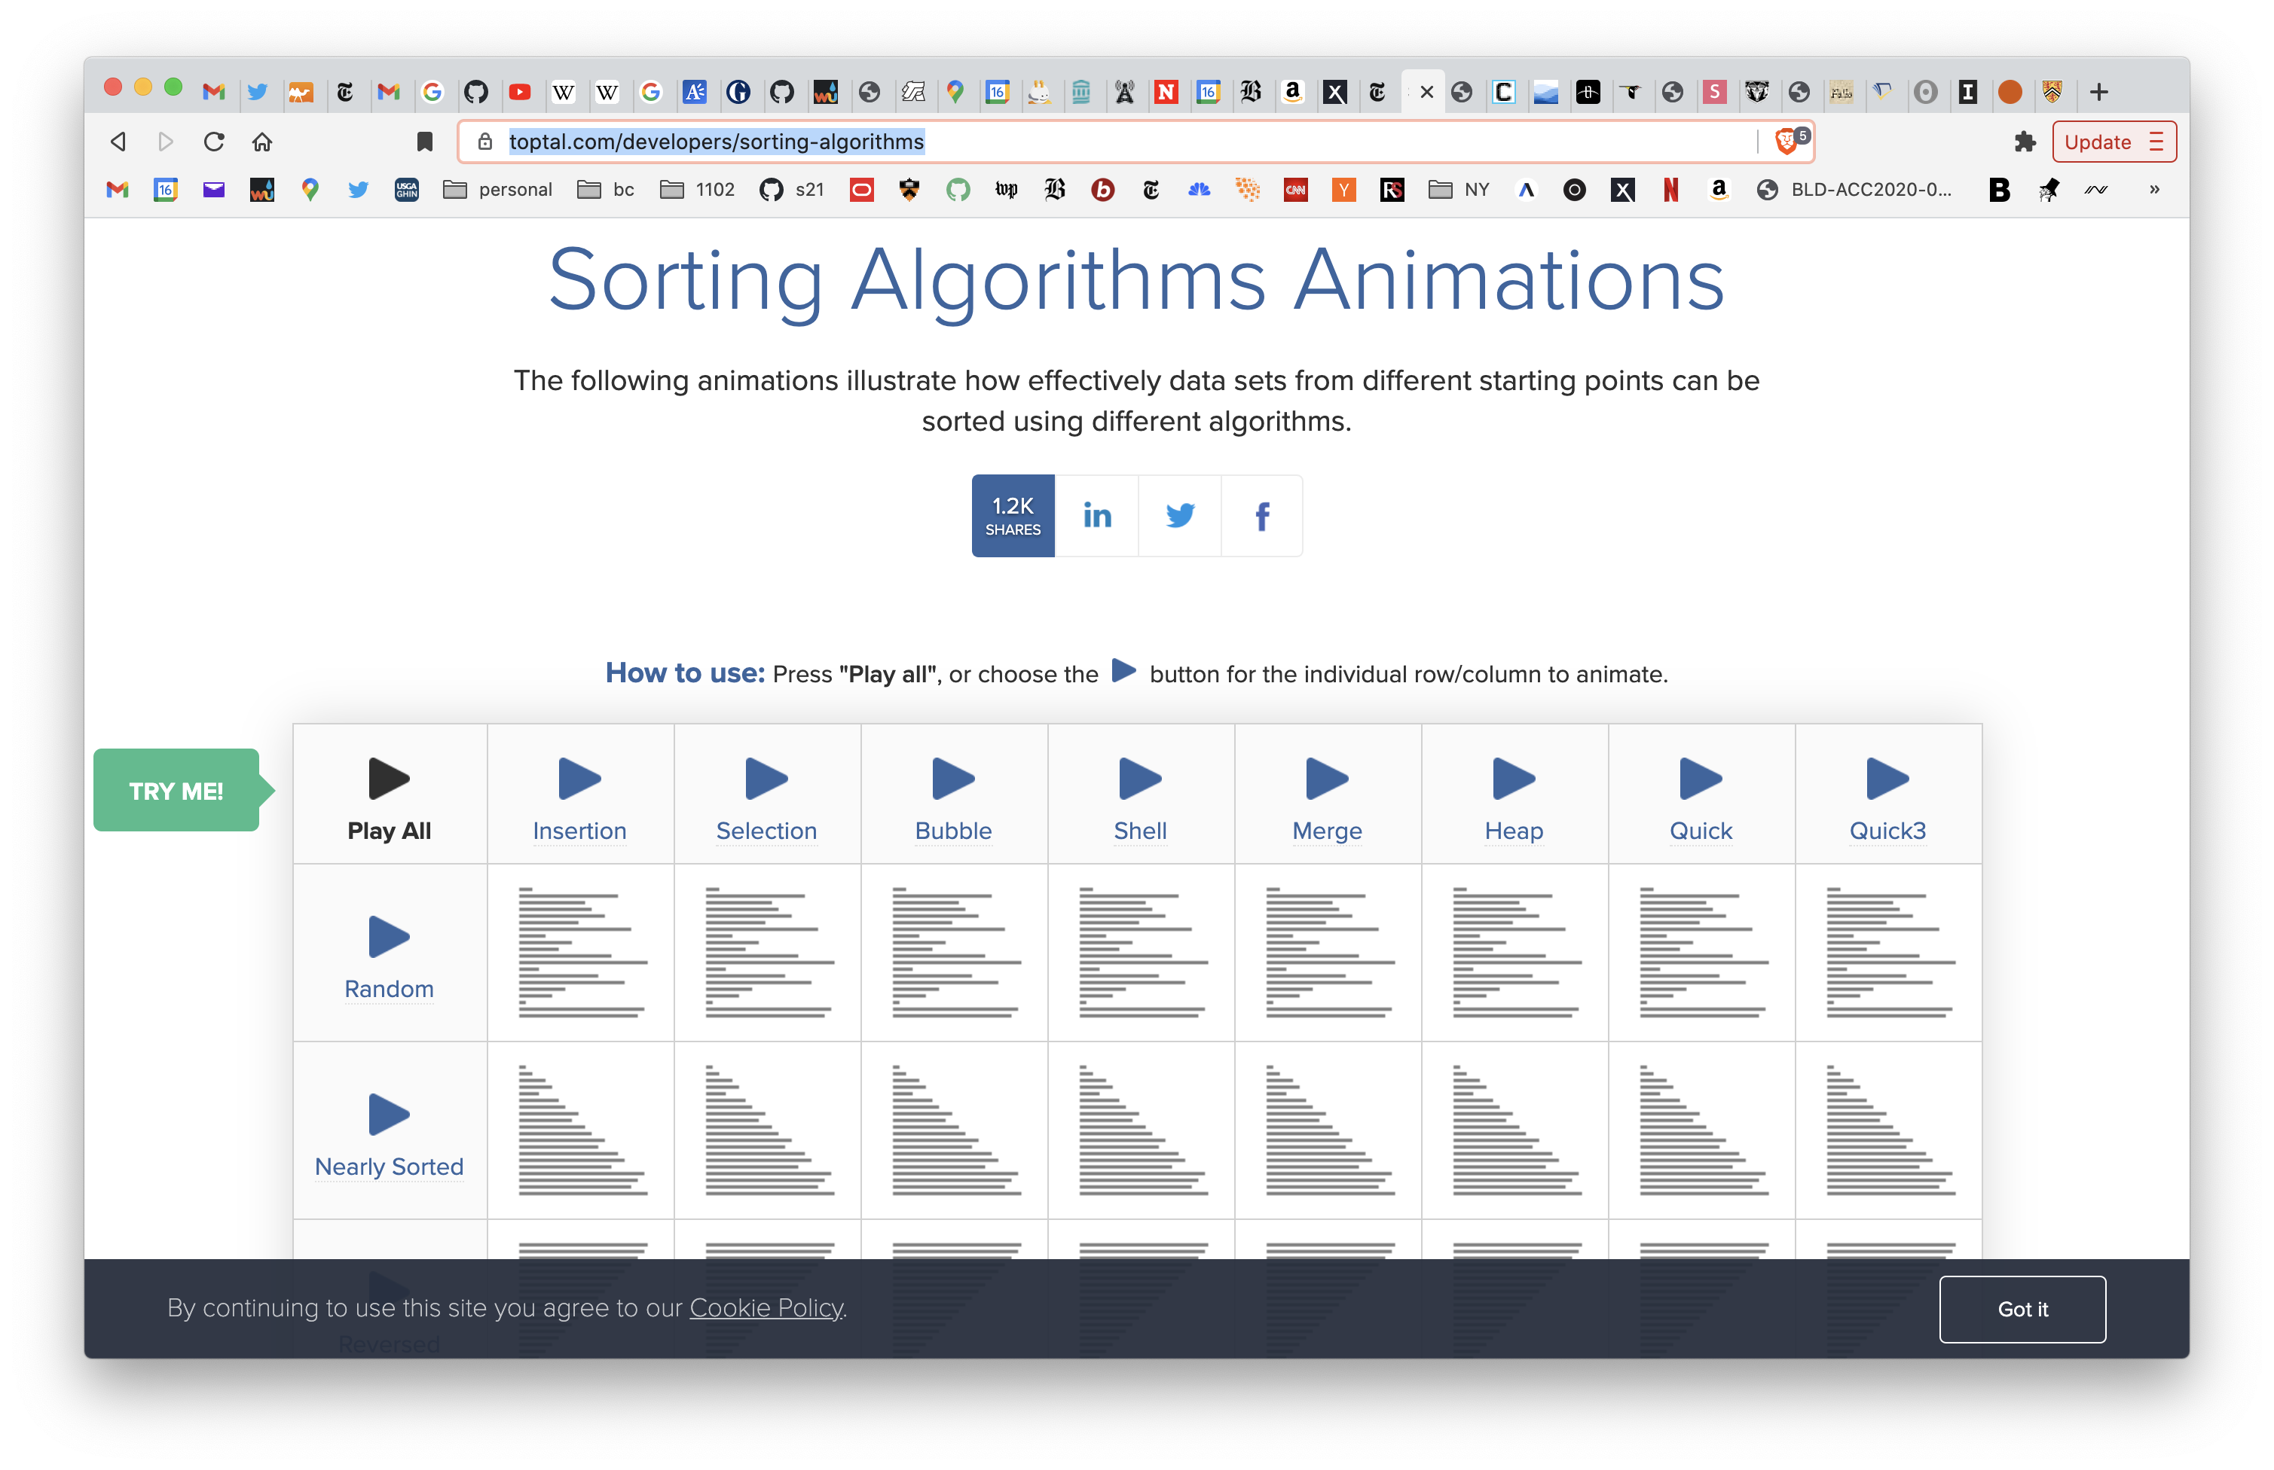

Slide 11
Heapsort
Bill Williams, 1964

Slide 12
E
1
X
A
2
3
M
P
L
E
4
5
6
7
E X A M P L E

Slide 13
Build heap: sink(3)
E
E
1
1
X
A
X
L
2
3
2
3
M
P
L
E
M
P
A
E
4
5
6
7
4
5
6
7

Slide 14
Build heap: sink(2)
E
E
1
1
X
L
X
L
2
3
2
3
M
P
A
E
M
P
A
E
4
5
6
7
4
5
6
7

Slide 15
Build heap: sink(1).
E
X
1
1
X
L
E
L
2
3
2
3
M
P
A
E
M
P
A
E
4
5
6
7
4
5
6
7

Slide 16
Build heap: after sink(2), heap is well-formed.
X
X
1
1
E
L
P
L
2
3
2
3
M
P
A
E
M
E
A
E
4
5
6
7
4
5
6
7

Slide 17
Sort: evict X, place it in used slot.
X
E
1
1
P
L
P
L
2
3
2
3
M
E
A
E
M
E
A
X
4
5
6
7
4
5
6
7

Slide 18
Sort: sink(1)
E
P
1
1
P
L
E
L
2
3
2
3
M
E
A
X
M
E
A
X
4
5
6
7
4
5
6
7

Slide 19
Sort: after sink(2), heap is restored.
P
P
1
1
E
L
M
L
2
3
2
3
M
E
A
X
E
E
A
X
4
5
6
7
4
5
6
7

Slide 20
Sort: evict P, place it in used slot.
P
A
1
1
M
L
M
L
2
3
2
3
E
E
A
X
E
E
P
X
4
5
6
7
4
5
6
7

Slide 21
Sort: sink(1).
A
M
1
1
M
L
A
L
2
3
2
3
E
E
P
X
E
E
P
X
4
5
6
7
4
5
6
7

Slide 22
Sort: after sink(2), heap is restored.
M
M
1
1
A
L
E
L
2
3
2
3
E
E
P
X
E
A
P
X
4
5
6
7
4
5
6
7

Slide 23
Sort: evict M from heap, place in unused slot.
M
A
1
1
E
L
E
L
2
3
2
3
E
A
P
X
E
M
P
X
4
5
6
7
4
5
6
7

Slide 24
Sort: after sink(1), heap is restored.
A
L
1
1
E
L
E
A
2
3
2
3
E
M
P
X
E
M
P
X
4
5
6
7
4
5
6
7

Slide 25
Sort: evict L from the heap, place in unused slot.
L
E
1
1
E
A
E
A
2
3
2
3
E
M
P
X
L
M
P
X
4
5
6
7
4
5
6
7

Slide 26
Sort: sink(1), no change, good heap, evict E.
E
A
1
1
E
A
E
E
2
3
2
3
L
M
P
X
L
M
P
X
4
5
6
7
4
5
6
7

Slide 27
Sort: after sink(1), heap restored.
A
E
1
1
E
A
A
E
2
3
2
3
L
M
P
X
L
M
P
X
4
5
6
7
4
5
6
7

Slide 28
Sort: after evict E, a one-element heap.
A
A
1
1
E
A
E
E
2
3
2
3
L
M
P
X
L
M
P
X
4
5
6
7
4
5
6
7
A E E L M P X

Slide 29
Stability
In this particular example, the order of E and E was preserved
When a sorting algorithm preserves the order of equal keys the algorithm is said to be stable.
E X A M P L E
A E E L M P X

Slide 30
Heapsort
Requires O(N log(N)) steps on average and in the worst case;
Sorts in place, no additional storage required.
In general, heapsort is unstable.

Slide 31
Mergesort
John von Neumann, 1945

Slide 32
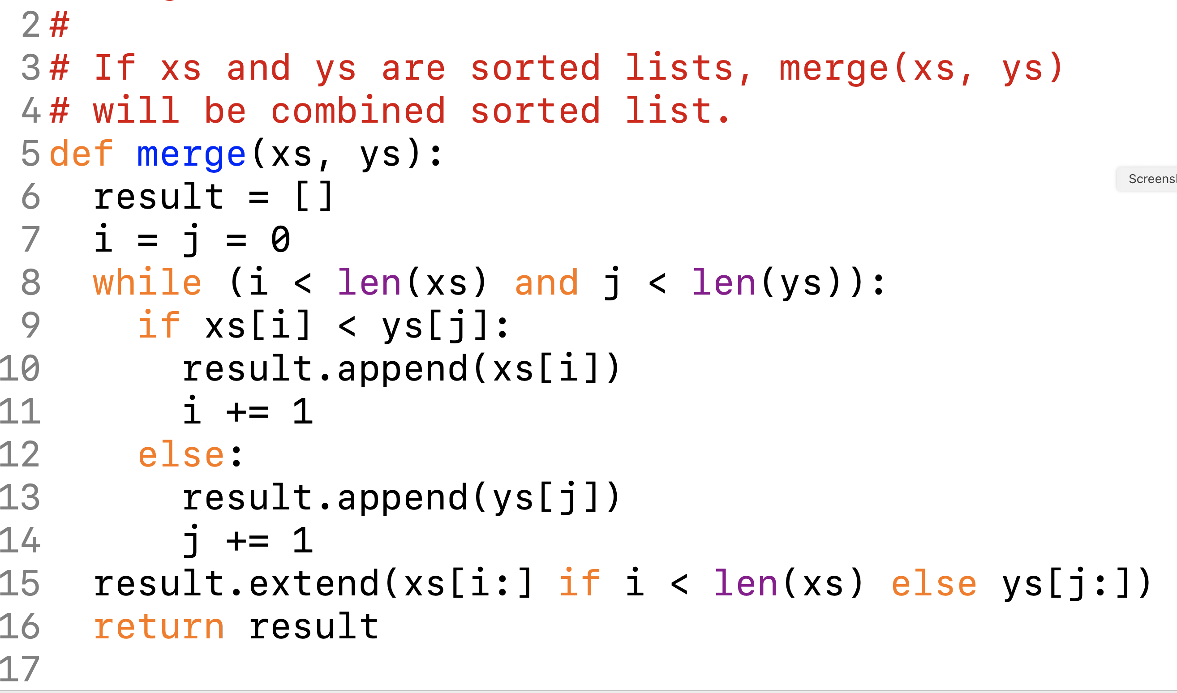

Slide 33
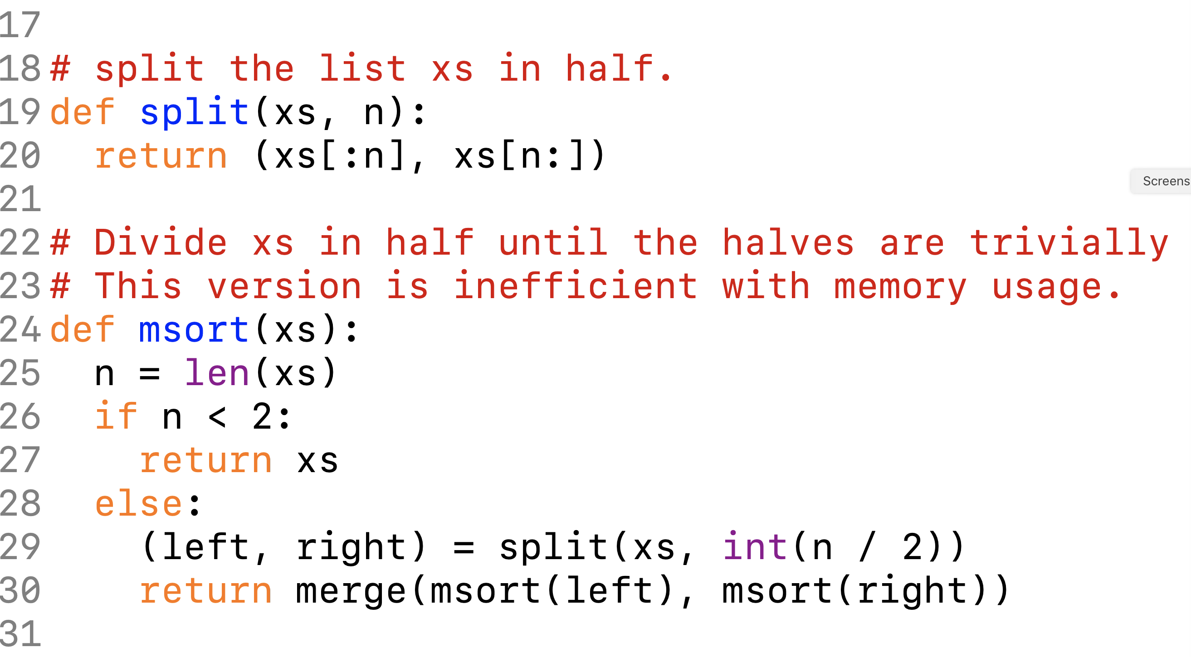

Slide 34
E
X
A
M
P
L
E
E
X
A
M
P
L
E

Slide 35
divide
E
X
A
M
P
L
E
E
X
A
M
P
L
E
E
X
A
M
P
L
E
X
A
M
P
L
E

Slide 36
E
X
A
M
P
L
E
merge
X
A
M
P
L
E
A
X
M
P
E
L
A
E
X
E
L
M
P
A
E
E
L
M
P
X

Slide 37
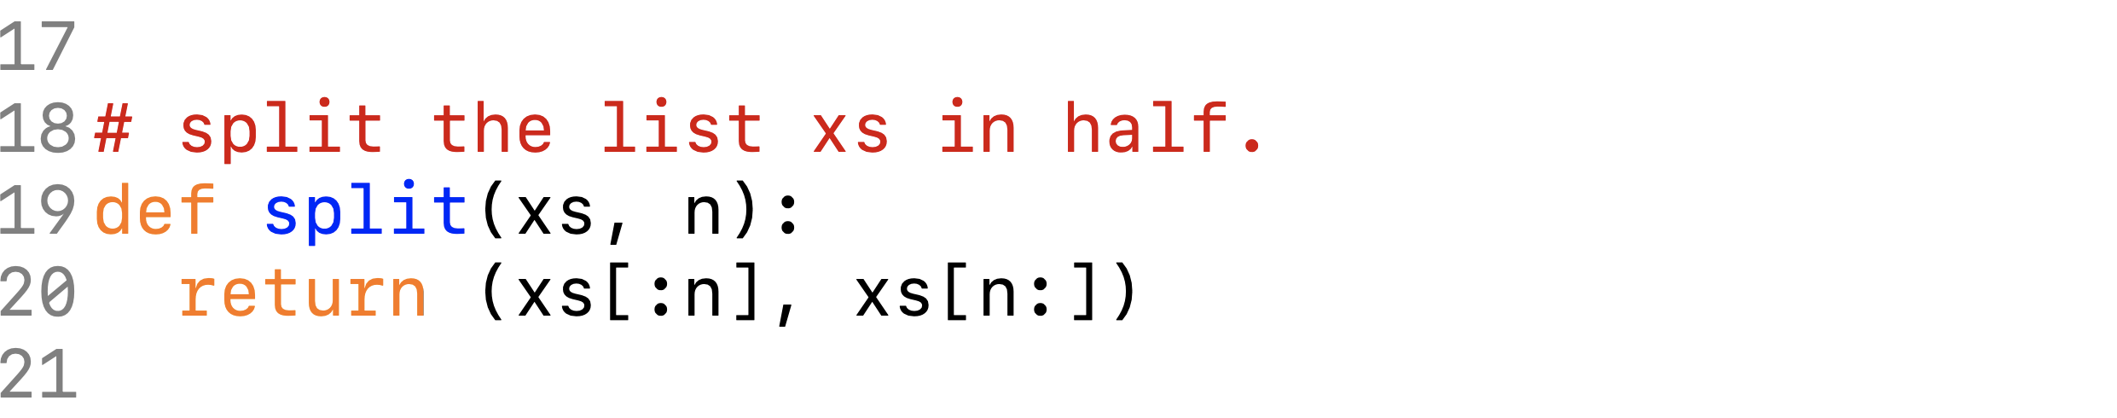
Memory Usage in Python
E
X
xs[:3]
E
X
A
A
(xs[:3], xs[3:])
M
M
P
P
xs[3:]
L
L
E
E

Slide 38
Memory Usage
E
A
Use another array as a work area.
X
E
A
E
M
L
P
M
L
P
E
X

Slide 39
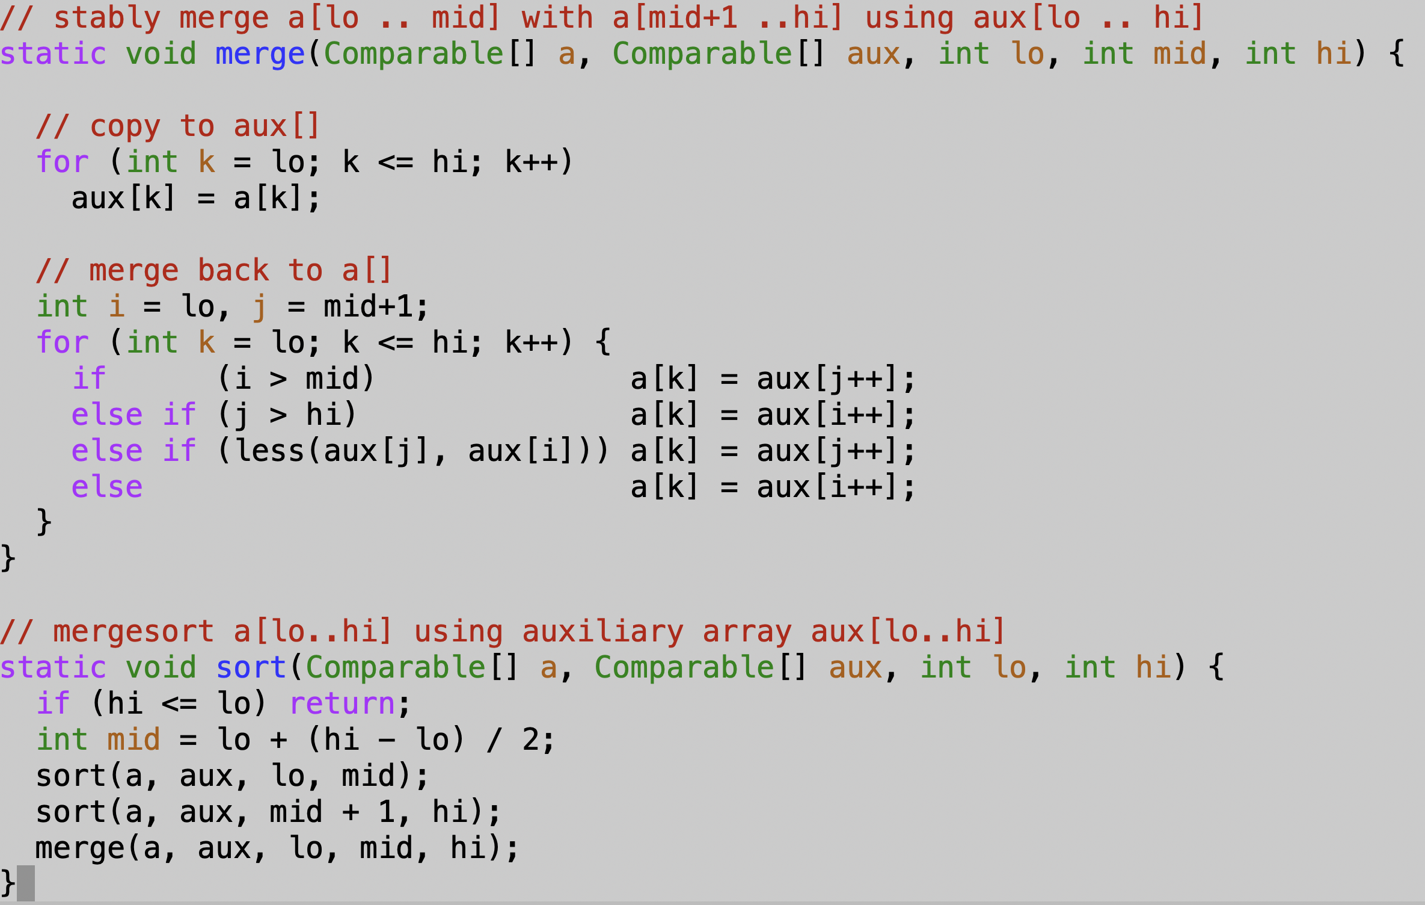

Slide 40
Mergesort
Requires O(N log(N)) steps on average and in the worst case;
Sorts using O(N) storage.
Mergesort is stable.

